Slide 1
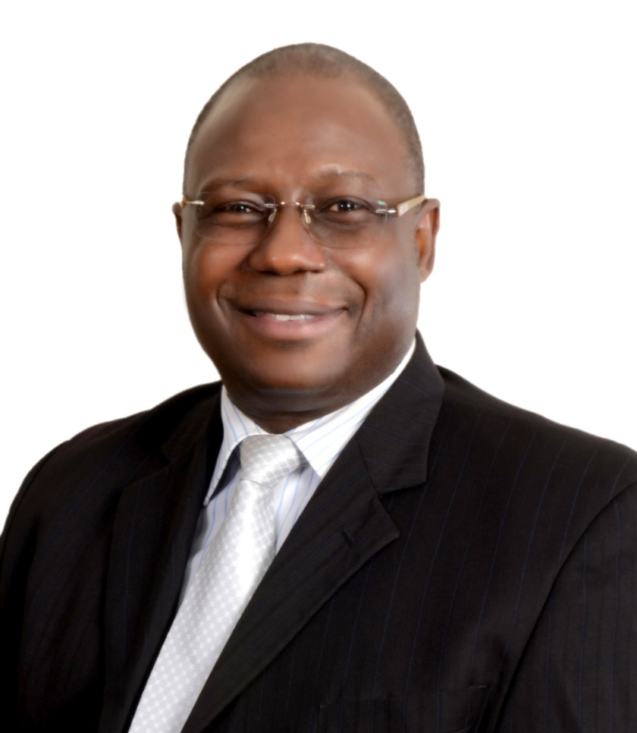
Dr. Yemi Akinbamijo
Executive Director of FARA, Ghana
Dr. Yemi Akinbamijo is an agriculture expert with a track record of leadership in food/nutrition security, rural development, agricultural and environmental sciences domain. He is the Executive Director of the Forum for Agricultural Research in Africa (FARA) with a continent-wide mandate on the coordination of agricultural research for development in Africa. Prior to his appointment as the Executive Director of FARA in 2013, Yemi was the Head of Agriculture and Food Security Division at the African Union Commission Headquarters in Addis Ababa, Ethiopia. His core competence is the implementation of continent-wide initiatives of the African Union Commission on Food Security and Agriculture. He has been in the frontline of the implementation of the Comprehensive African Agricultural Development Programme (CAADP), now operating in 40 African Union Member States.
A thought and process leader on the continent, Dr. Akinbamijo is an agricultural research and development specialist with considerable expertise in natural resource management including crop-livestock integrated systems, market-oriented production systems, regional value chains, sustainable agriculture and climate change adaptation strategies. He is an experienced research manager with proven strength in project development; monitoring and results-based evaluation.
As a CAADP Specialist, Yemi Akinbamijo is a strong analytical and strategic thinker who is fully engaged in the current global discourse on Agricultural/ecological transformations and investments in Africa, especially with regard to food security, land use, biodiversity, climate change/climate smart approaches, ecological and organic agriculture and their inter-linkages.
With more than 30 years in the practice of agriculture and rural development, he has served with increasing responsibilities and leadership roles in institutions with national, regional and continental mandates, including as a Diplomat/Head of Mission.

Slide 2
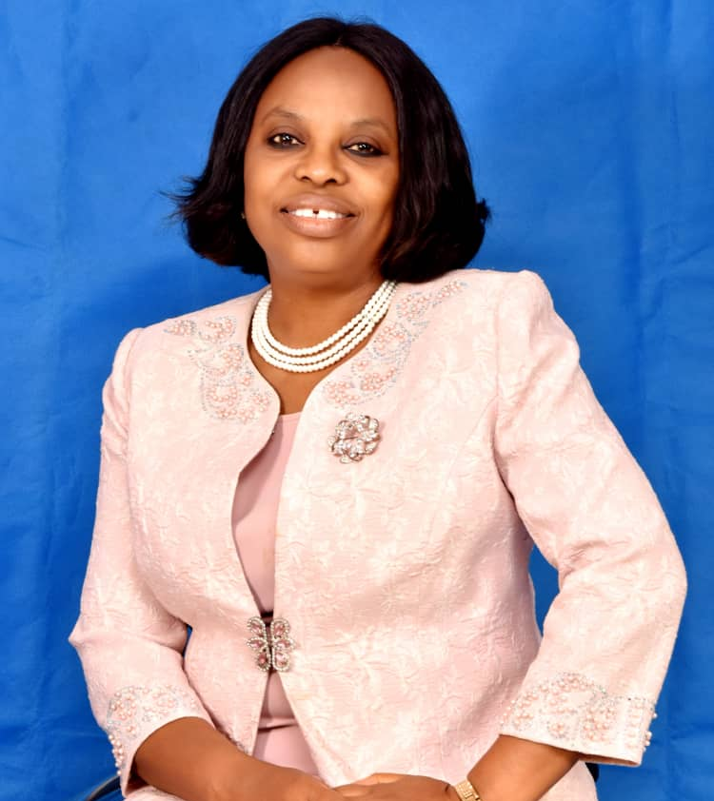
Prof. Chinedum Babalola
Vice-Chancellor of Chrisland University Abeokuta
Chinedum Peace Babalola is the Vice-Chancellor of Chrisland University Abeokuta, a Pharmacist and Professor of Pharmaceutical Chemistry/Pharmacokinetics from University of Ibadan (UI).
Her research focuses on pharmacokinetics/pharmacodynamics (PK/PD), pharmacogenetics, clinical trials/bioethics, quality assurance and drug development
She has received over 25 grants, awards and fellowships including a MacArthur grant (approx. $1m) to set up the Centre for Drug Discovery, Development and Production (CDDDP) in University of Ibadan with the goal of building capacity for Africa to discover, manufacture and regulate her own medicines. CDDDP has a number of medicinal and herbal products ready for registration.
She is currently one of the six focal Principal Investigators for the USAID-USP Project on Promoting Quality of Medicines-Plus (USP-PQM+). She is presently leading a multidisciplinary team (as the PI) for a TETFUND intervention grant on “Identification of Potentially Effective Local Therapies against COVID-19”.
Babalola has recorded many firsts and received several prizes and awards. She is a Fellow of Nigerian Academy of Science (FAS); African Academy of Sciences (FAAS), Pharmaceutical Society of Nigeria (FPSN), Nigerian Academy of Pharmacy (FNAPharm) among others. She was selected twice (2016 & 2018) as one of 10 most influential female scientists in Nigeria.
The cap of her prizes so far is the 2019 African Union Kwame Nkrumah Regional Prize for Scientific Excellence –making her an African Union (AU) Laureate.
She has over 160 publications (peer-reviewed and abstracts) and has supervised over 50 postgraduate students. She is married to a supportive husband Rev’d Collins Babalola and blessed with children.

Slide 3
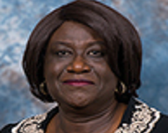
Dr. Omobola A. Oyeleye
Assistant Professor
Dr. Oyeleye is a graduate of University of Ife in 1981, where she earned a bachelors degree in Education, (English).
She taught for a few years in Nigeria before she went to the United States. Her time in the United States has included a cosmetology license, masters in education, a law degree, a bachelors and masters degree in nursing and a doctorate in higher education. Her work experience has spanned law, nursing, and education.
She is currently a full-time faculty at the Cizik School of Nursing at the University of Texas School of Nursing.Dr. Oyeleye’s scholarship and service interests are in education, disabilities, and Diversity Equity, and Inclusion issues. She is a conference speaker and serves on the boards of several organizations.

Slide 4
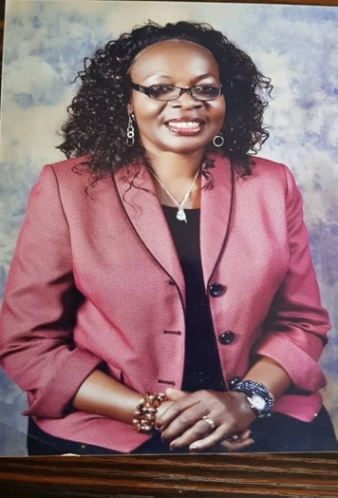
Prof. Nkadi Onyegegbu
Head of Department, University of Nigeria
Prof. Nkadi Onyegegbu is at present, Professor in the Science Education Department, current Head of the Department, past Director, Institute of Education; Professor and Reproductive Health and Sexuality Educator in Science Education Department of University of Nigeria, Nsukka. She holds a BSc. in Microbiology, a PGDE in Science Education, M.Ed. and Ph.D. in Science Education. Her academic career is garnished with strings of academic publications. She has edited fifteen books, contributed chapters in many books and has published avalanche of academic articles in renowned national and international journals. Her professional activities can be measured by her membership in ten professional societies and associations. She is also a Director in Global Health Awareness Research Foundation), Lift Saxum, and Women Leadership Institute International (WLI). As a researcher, Professor Nkadi Onyegegbu has severed as a consultant to many international organizations including the World Health Organization [WHO], United Nations Children’s Fund [UNICEF], John D, & Catherine T MacArthur Foundation, Action Aids, Rainbow West Africa, Ford Foundation, UNDP, UKAID, DFID, UBE, Federal Ministry of Health, Nigeria and MDG, NYSC and National Reproductive Health, HIV & AIDs. As an academic and active researcher, she has globally traveled. She has delivered keynote addresses and Lead Paper presentations in a number of conferences. She has also conducted a number of funded researches and facilitated as Lead Resource Person in a number of sponsored capacity building workshops, seminars and training programs for teachers and youths. Currently, she is a part time National Consultant for UNICEF on WASH, Wins4Girls MHM research Project. A member of Mannion Daniels, AmplifyChange, UK Technical Review Panel

Slide 5
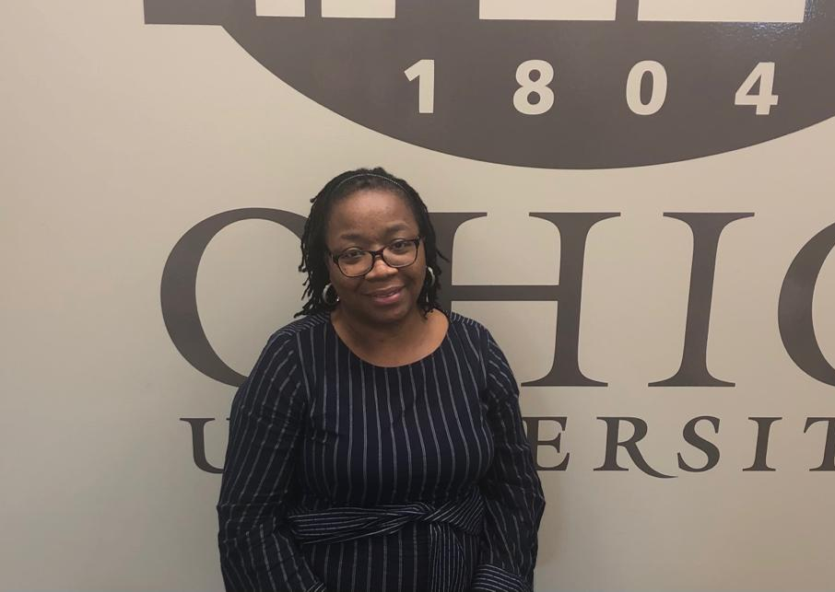
Mrs. Ada Nworie
Nurse
Ada Nworie is a Registered Nurse with over 20years experience in Healthcare. She also has an MBA in Marketing and Supply Chain from Penn State University, USA. Based in the United States, she started Protem Homecare; a Medicare-certified homecare agency in 2006, Protem Hospice in 2014 and more recently, Alliant Treatment Center in 2017. Ada Nworie is an addiction counselor in Shaker Heights, Ohio.She is currently enrolled in a Doctor of Nursing Practice (DNP) program at the Ohio University in Athens, Ohio.

